Slide 1
Ensemble Methods
By Chode Amarnath

Slide 2
Nowadays it is hard to find a competition won by a single model! Every winning solution incorporates ensembles of models. In this module we will talk about the main ensembling techniques in general, and, of course, how it is better to ensemble the models in practice.
Learning Objectives
Describe and compare ensembling methods
List and describe plan of validation schemes for ensembling
Compare validation schemes
Successfully implement ensembling in practical task
Why should we consider Bagging?

Slide 3
Python code for Ensemble methods
https://github.com/Amarnathchode/Ensembling-implementation-

Slide 4
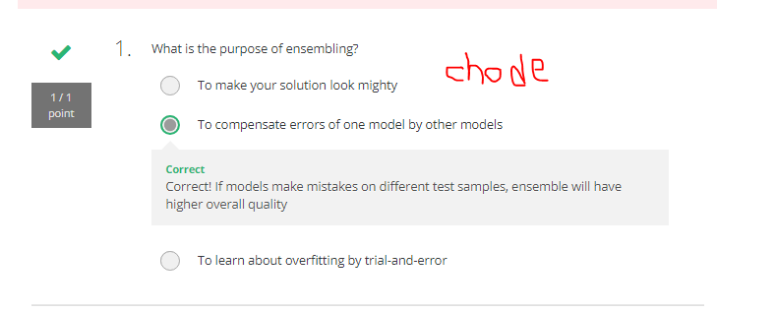

Slide 5
What is ensemble modelling?
It means combining different machine learning models to get a better prediction.
Learning Objectives
→ Describe and compare ensembling methods
→ List and describe plan of validation schemes for ensembling
→ Compare validation schemes
→ Successfully implement ensembling in practical task
There are various ensemble methods.

Slide 6
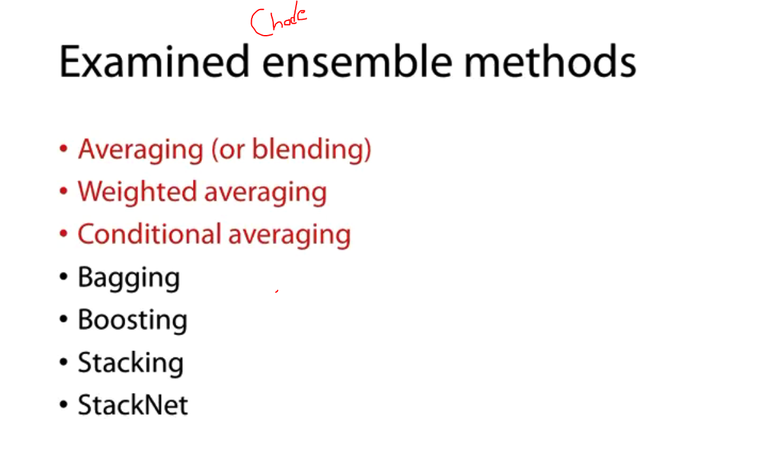

Slide 7
Averaging ensemble methods
Let’s say we have a variable Age, and we try to predict this
→ we have a model that yields prediction for age.
→ Let’s assume that the relationship between the two, the actual age in our prediction, looks like in the graph below.
→ So you can see that the model boasts quite a higher square of a value of 0.91.
→ So when age is less than 50, the model actually does quite well.

Slide 8
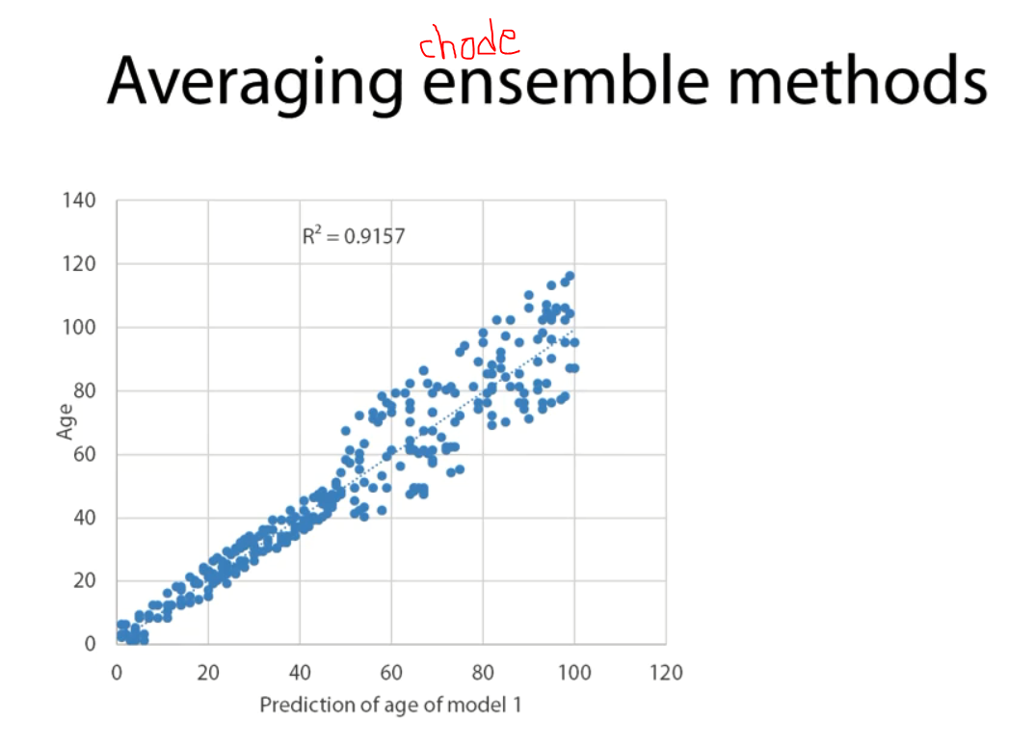

Slide 9
→ When age is more than 50, you can see that the average error is higher.

Slide 10
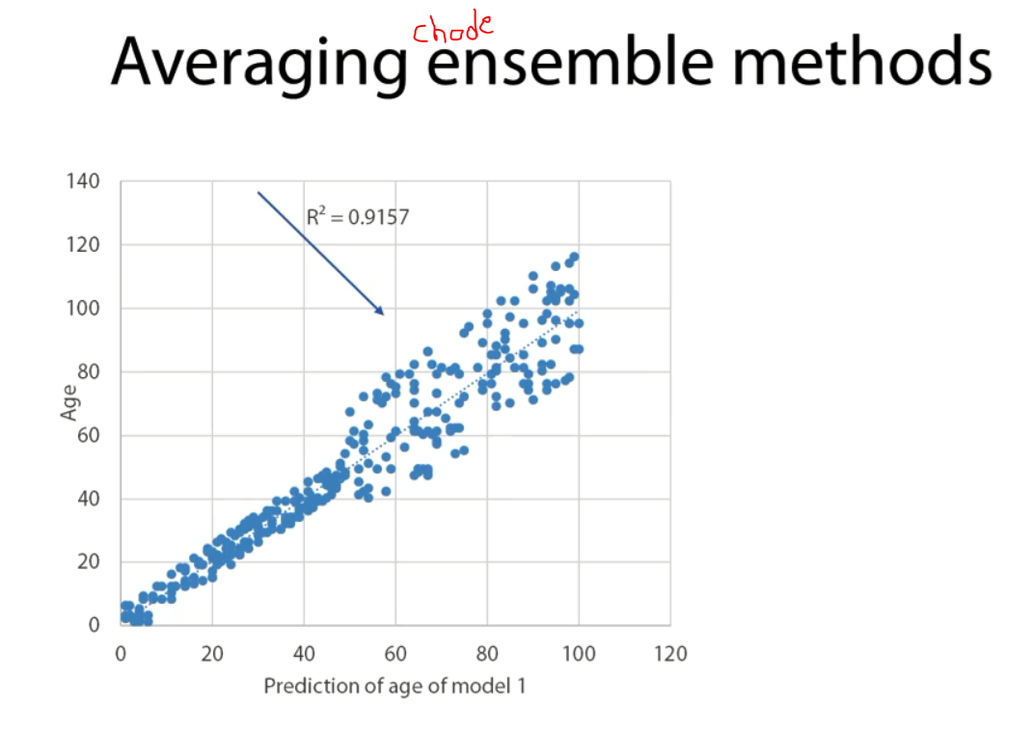

Slide 11
Another Example
Let’s assume we have a second model that also tries to predict age,
→ As you can see below, this model does quite well on when age is higher than 50.
→ But, not so well when age is less than 50, and the score is same.
→ So we have two models that have a similar predictive power, but they look quite different.
→ It’s quite obvious that they do better in different parts of the distribution of age.

Slide 12
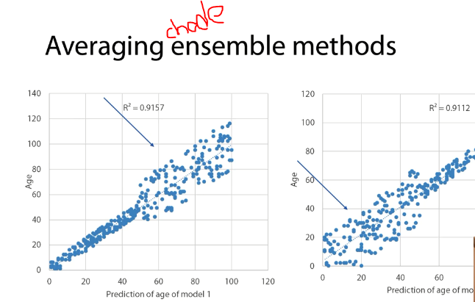

Slide 13
So what will happen if we were try to combine these two with a simple averaging method
→ ( Model1 + model2 ) / 2.
→ The end result will look as in the new graph.
→ so, our square has moved to 0.95, which is a considerable improvement versus the 0.91.
→ On the average, the points tend to be closer with the reality.
→ So the average error is smaller.

Slide 14
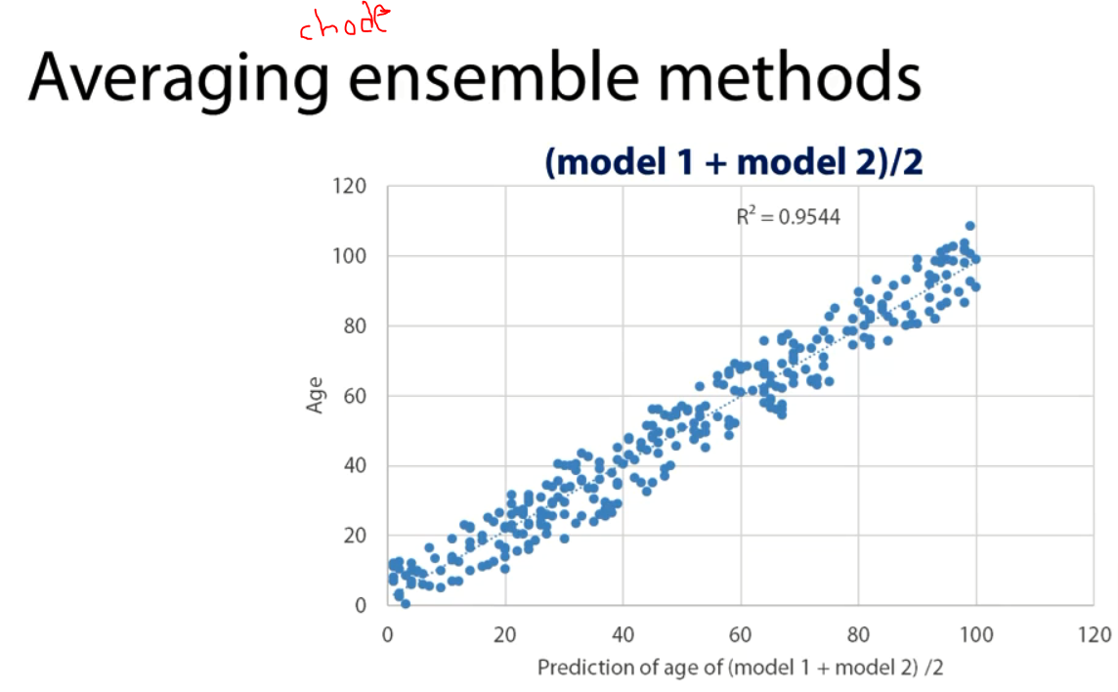

Slide 15
However, as you can see, the model doesn’t do better as an individual model for the areas where the models were doing really well, it does better on average.

Slide 16
Weighting Average
I’m going to take 70% of the first model prediction and 30 % of the second model prediction.
→ In other words, (model 1* 0.7 + model 2*0.3).
→ The end result will be below graph.
→ You can see their square is no better and that makes sense, because of the model have quite similar predictive power and it doesn’t make sense rely more in one.
→ And also it is quite clear that it looks more with model 1, because it has better predictions.
→ Worse prediction when age is 50.

Slide 17
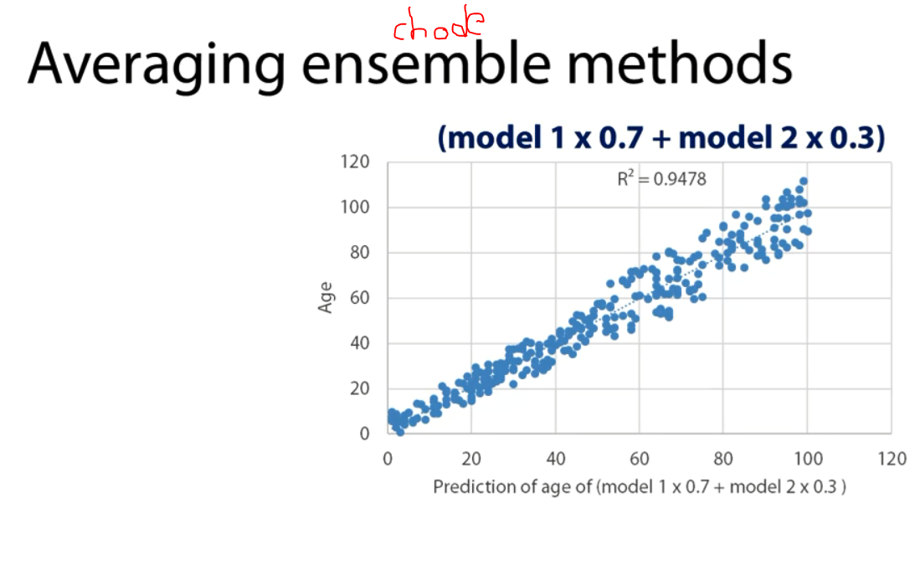

Slide 18
We know that we have a model that score really well when the age is less than 50, and in another model that score really well when the age is more than 50.
→ Here by using a simple conditioning method.

Slide 19
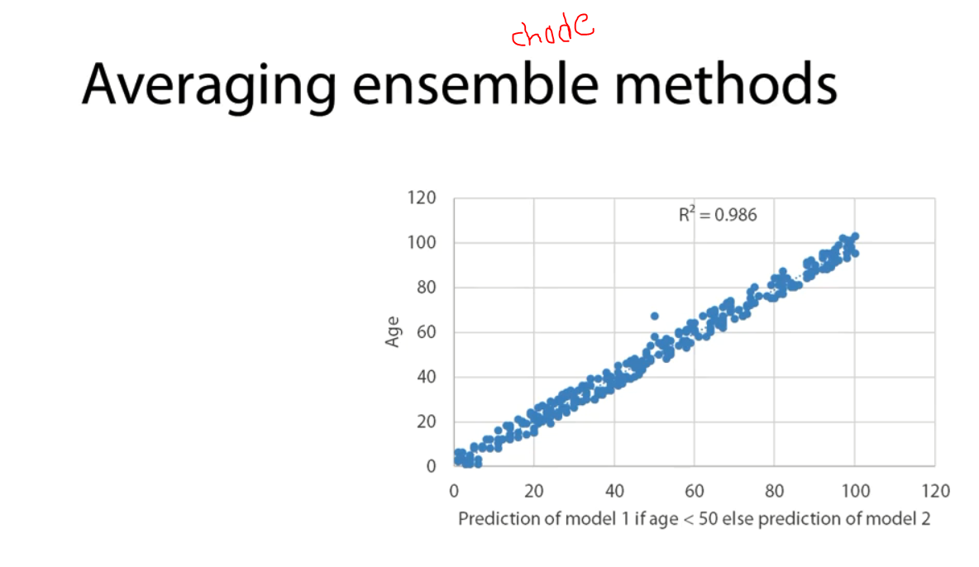

Slide 20
There are ensemble methods that are very good at finding these relationship of the target variable.

Slide 21
Ensemble method - Bagging
Which is very popular and efficient form of ensembling
What is bagging?he predictive
Bagging refer to averaging slightly different version of the same model as a means to improve the predictive power.
We can average many different models, which are independent to each other in order to get a better prediction.
A common and quite successful application of bagging is the Random Forest.
→ Where you would run many different versions of decision trees in order to get a better prediction.

Slide 22
Why should we consider Bagging?
Generally, in the modelling process, there are two main sources of error.
→ Errors due to bias often referred to as Bias(Underfitting)
→ Errors due to variance(Overfitting).

Slide 23
Example
Example of high bias and low variance
We have a person who is let’s say young, less than 30 years old and we know this person is quite rich and we’re trying to find him, if this person who’ll buy a racing or a expensive car.
→ Your model has low variance, high bias , if it says that this person is young and i think he’s not going to buy an expensive car.
→ What the model has done here is that it hasn’t explore very deep relationship within data.
→ It hasn’t explored different relationships, it has been underfitted

Slide 24
However, this also associated with low variance because this relationship, the fact that a young person generally doesn’t buy an expensive car is generally true
→ So we would expect this information to generalize well enough for seen data.
→ the variance is low in this example.

Slide 25
Example : 2
Example with high variance and low bias
Let’s assume we have a person, he lives in a greenhouse has brown eye and we want see he will buy a car.
→ A model that has gone so deep in order to find these relationships actually has a low biad.
→ Because it has really explored a lots of information about the training data.
→ however, it is making the mistake that every person that this character is going to buy a car.
→ Therefore, it generalize for some thing that it shouldn’t.
→ we actually have high variance but low bias.

Slide 26
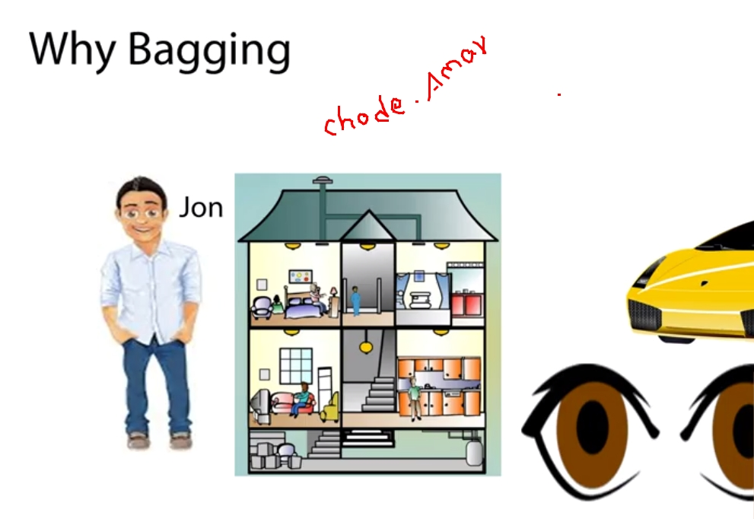

Slide 27
Visualize the relationship
If we were to visualize the relationship between prediction error and model complexity,
→ when we begin the training of the model, we can see that the training error make the error in that training data gets reduced.
→ same happen in the test data because the predictions are easily generalizable.
However, after a point any improvement in the training error are not realized into test data.
→ this is the point where the model starts over exhausting information, creates prediction that are not generalizable.
→

Slide 28
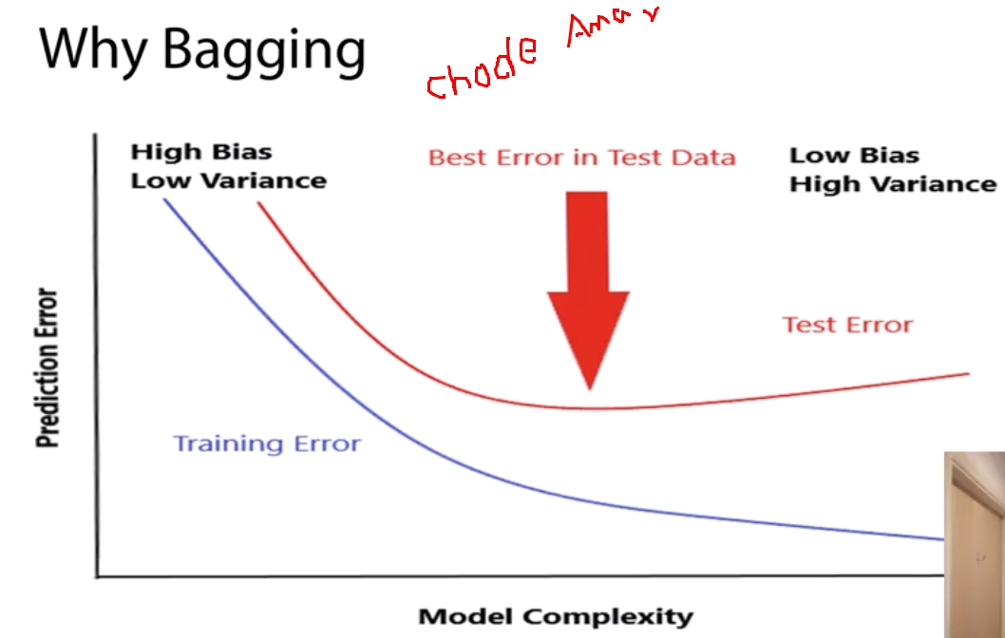

Slide 29
This is where Bagging actually comes into play and offer it’s utmost value.
→ By making slightly different or let say randomized models, we ensure that the predictions do not read very high variance.
→ we don’t over exhaust the information in the training data.
→ At the same time, we saw before that when you average slightly different models, we are generally able to get better predictions.

Slide 30
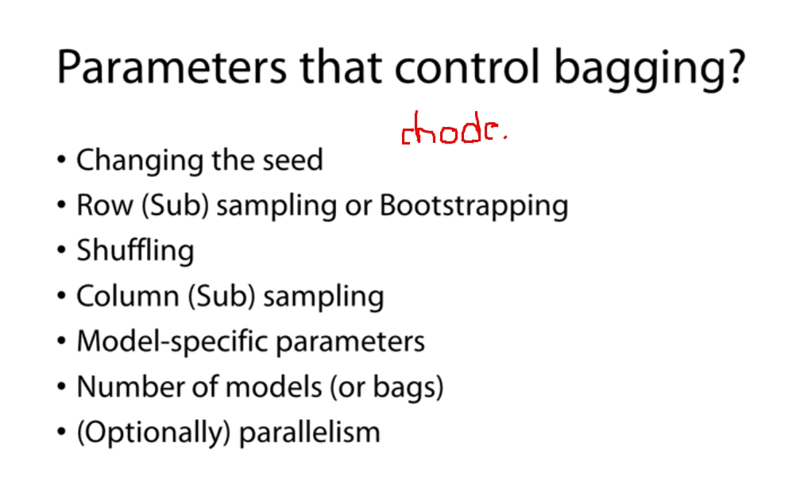

Slide 31
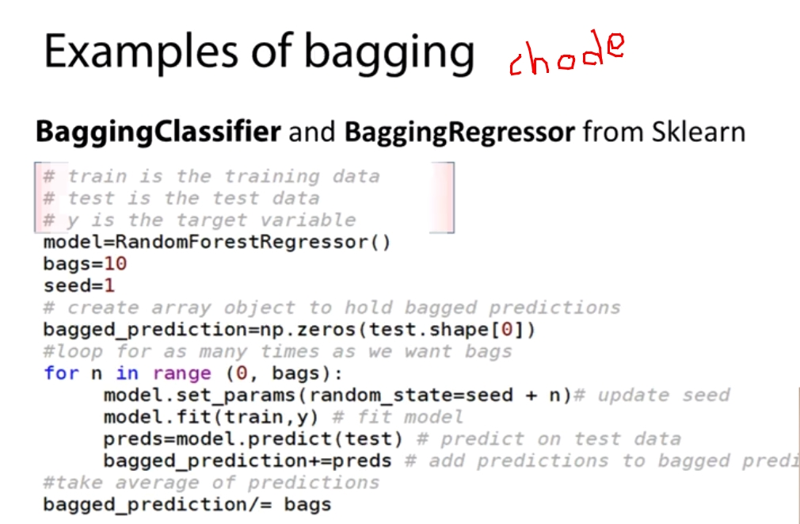

Slide 32
Ensemble Method - Boosting
What is Boosting?
À form of weighted averaging of models where each model is built sequentially via taking into account the past model performance.
Bagging
We can average many different models, which are independent to each other in order to get a better prediction.
Boosting says, now i tried to make a model, but i take into account how well the previous model have done in order to make a better prediction.
→ So, every model we add sequentially to the ensemble, it takes into account how well the previous model have done in order to make a better predictions.

Slide 33
Boosting Types
There are two main boosting types of algorithms.
1) Weight based
2) Residual based

Slide 34
Weight based boosting
Example:
Let’s say we have a tabular dataset, with four features and we want to use this features to predict a target variable Y.
What we are going to do in weight boosting is,
→ We are going to fit a model.
→ Generate predictions(call Pred).
→ These predictions have certain margin of error.
→ We can calculate this absolute error(Y - our prediction),
→ we generate a new column(weight), we say this weight is 1 + the absolute error

Slide 35
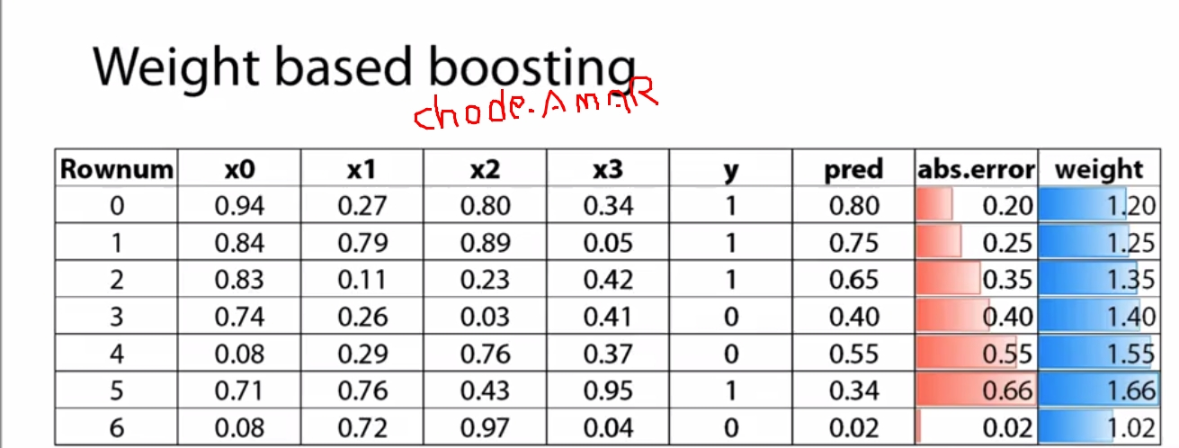

Slide 36
We’re going to fit a new model using the same features and the same target variable, but we’re going to also add this weight column.
What weight says to the model is,
→ Put more significance into a certain role.
→ Yo can almost interpret weight has the number of times that a certain row appear in my data.
→ Let’s say weight was 2, this means that this row appears twice, and therefore, has a bigger contribution to the total error.

Slide 37
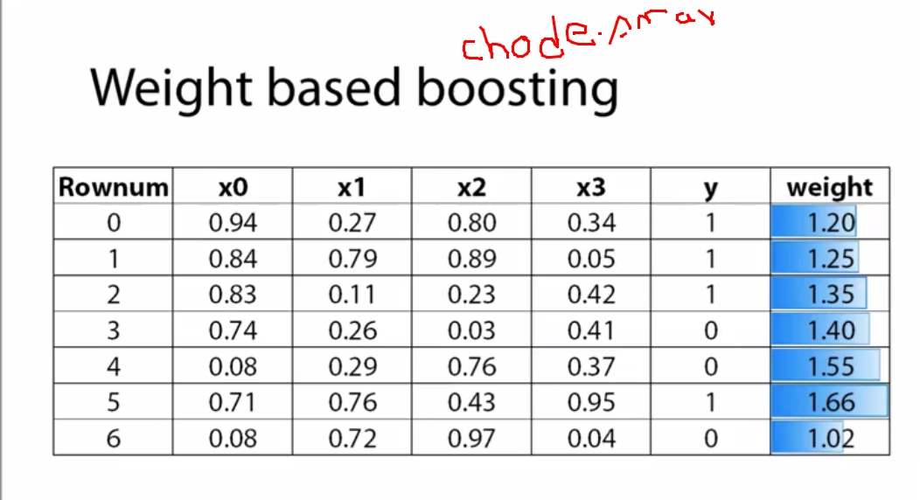

Slide 38
Keep repeating this process.
→ You can, again, calculate a new error based on this error, you calculate new weights.
→ This how you sequentially add models to the ensemble that take into account how well each model has done in certain cases, maximizing the focus from were the previous models have done more wrong.

Slide 39
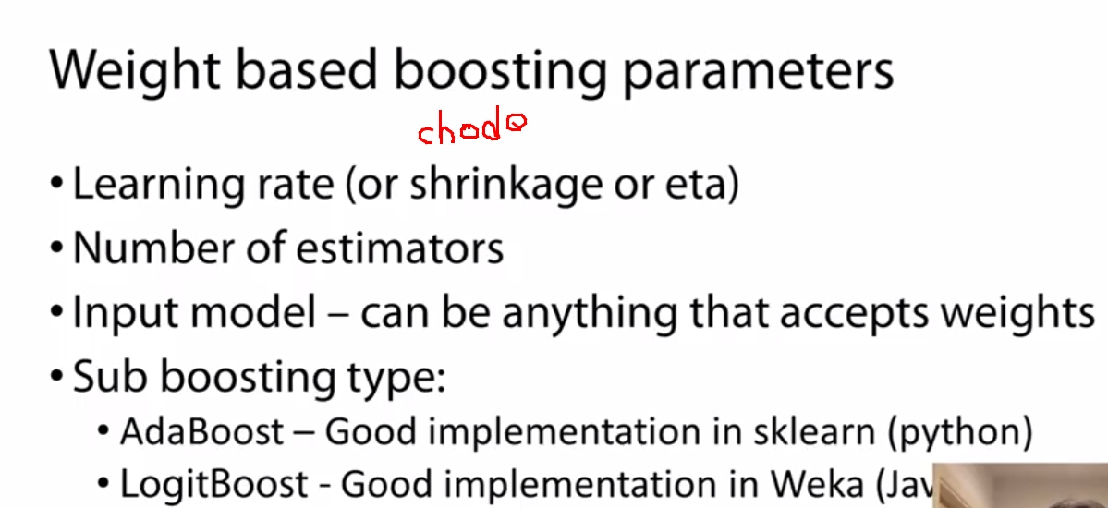

Slide 40
Residual based boosting
This type of boosting has been extremely successful for competitions.
Let’s say we have the same data set, same features, again we try to predict a Y variable
→ we fit a model, we make predictions(pred).
→ We’ll calculate the these prediction but this time,
→ This time not in absolute term, because were interested about the direction of error.

Slide 41
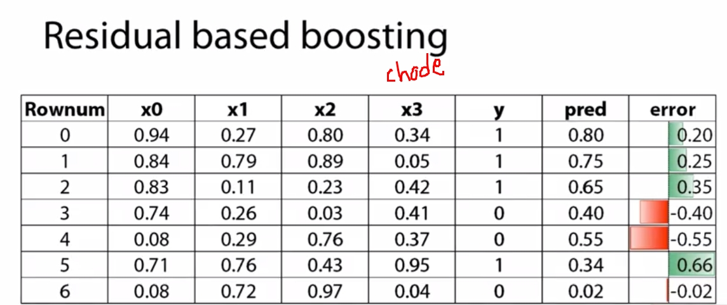

Slide 42
What we do next is we take this error and we make it adding a new Y variable so the new error now becomes the new target variable and we use the same features in order to predict this error(New pred).
→ we’ll take your initial prediction and then we’ll add the new prediction, which is based on the error of the first prediction.
→

Slide 43
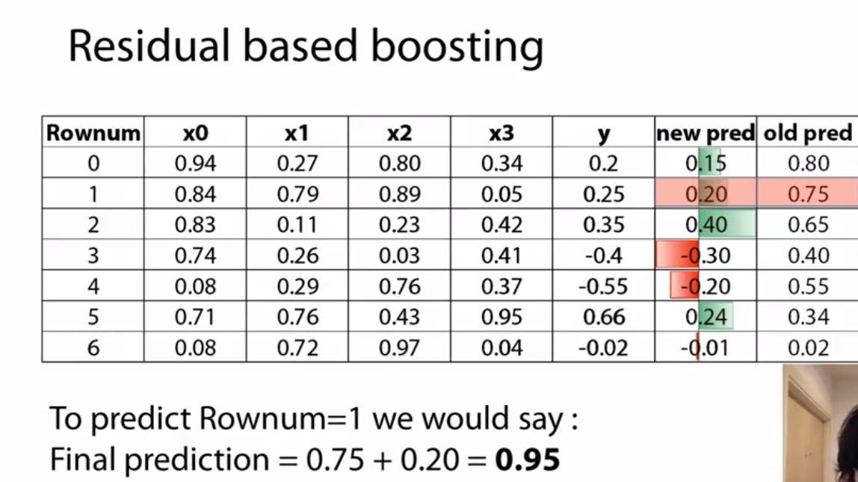

Slide 44
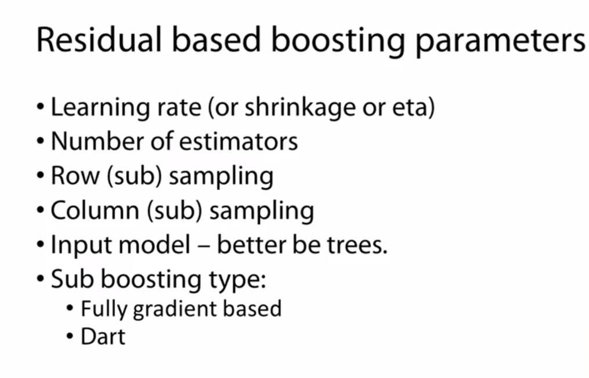

Slide 45
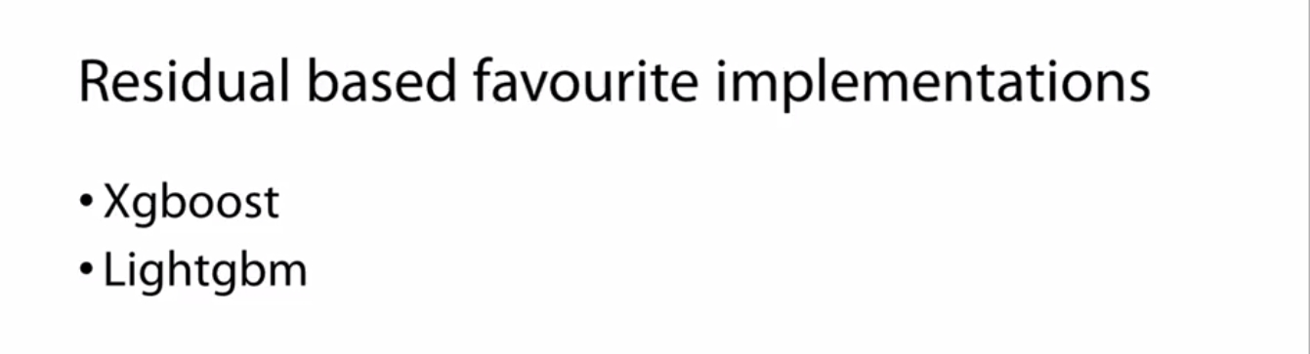

Slide 46
Ensemble methods
There is a form of stacking in the end in order to boost your performance as best as you can
What is stacking?
Means making predictions of a number of models in a hold-out set and then using a different (Meta) model to train on these predictions.

Slide 47
This is a new concept because we’re only going to use the predictions of some models in order to make a better model.
Example:
Let’s assume we have three kids, name them LR, SVM, KNN they argue about a physics question.
→ So each one believe the answer to a physics question is different first one says 13, second says 18, third says 11 they don’t know how to solve this disagreement.
→ So you can almost see the kids, there’s different models here, they take input data(Question).
→ They processed it based on historical information and they are able to output an estimate, a prediction.

Slide 48
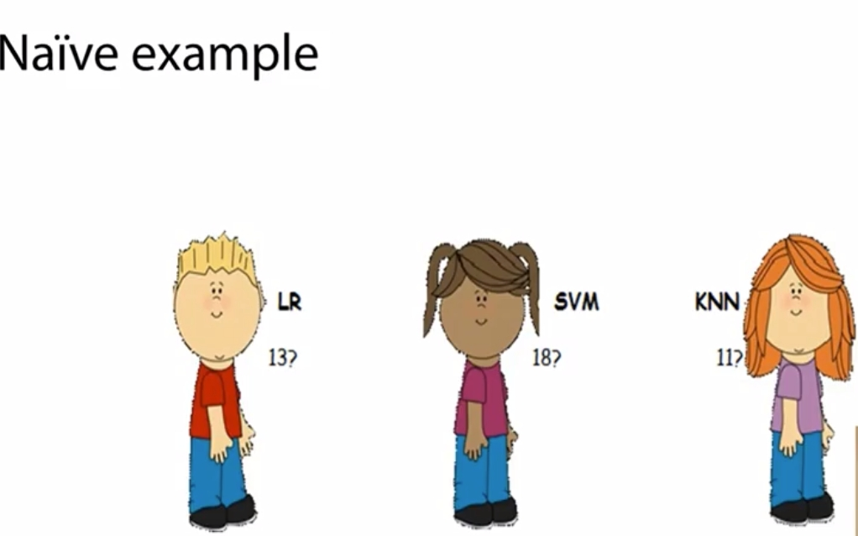

Slide 49
Another way to say this is to say there is to say there was a teacher,
→ Miss DL, who had seen this discussion and she decided to step up.
→ While she didn’t know the question, she does know the students quite well,
→ She knows the strength and weakness of each one.
→ She knows how well they have done historically in physics questions.
→ And from the range of values they have provided, she is able to give an estimate.
→ Let’s say that in this concept, she knows that SVM is really good in physics, and her father works in department of physics.
→ Therefore she should have bigger contribution to this ensemble than every other kib.
→ The answer is 17.
Notes:
Other

Slide 50
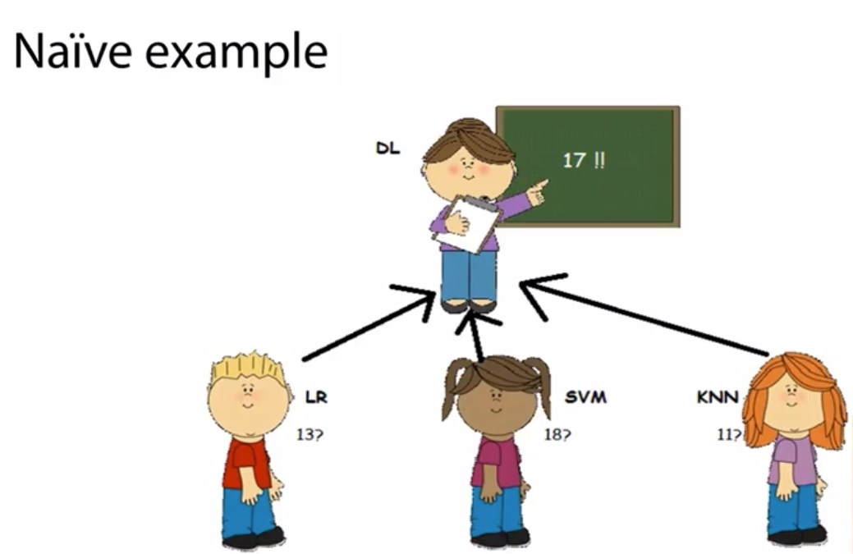

Slide 51
An this is how a meta model works, it doesn’t need to know the input data.
→ It just knows how the models have done historically, in order to find the best way to combine them.
→

Slide 52
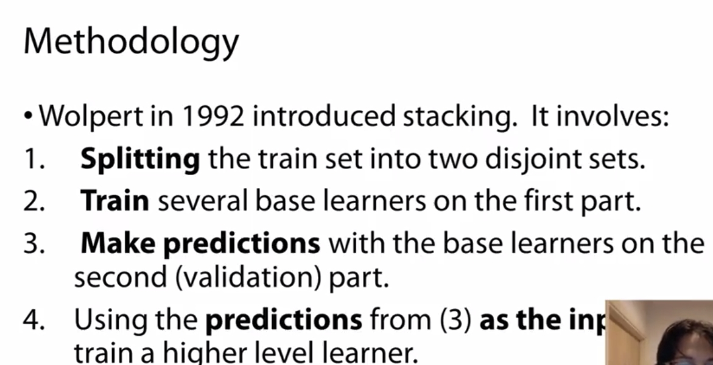

Slide 53
Let’s assume we have three data sets A, B, C.
→ In this case, A will serve the role of the training data set, B will be the validation set, C will be test data set where we want to make the final predictions.
→ They all have similar architectural, four features, and one target variable to predict.
So in this case, we can choose an algorithm to train a model based on data set 1 and then we can make predictions for B and C at the same time.
→ know we take this predictions and we put them into a new dataset.
→ So we create a dataset to store the predictions for the validation data in B1 and C1 to save predictions for the test data

Slide 54
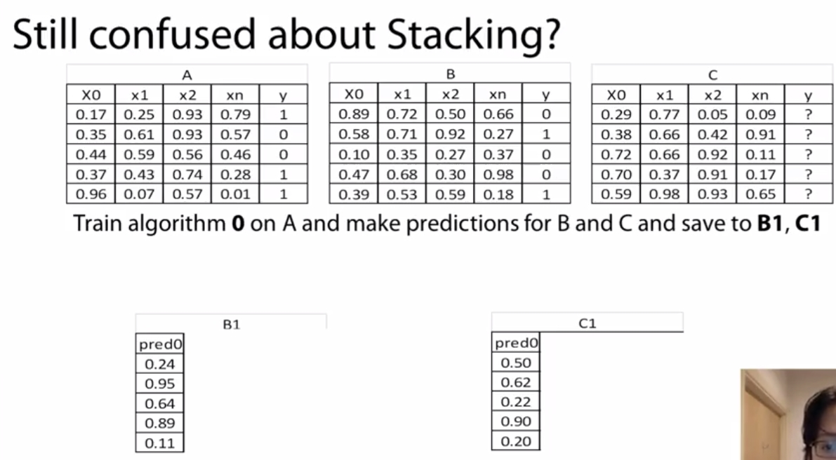

Slide 55
Then we’re going to repeat the process,
→ now we’re going to choose another algorithm.
→ Again, we will fit it on A dataset.
→ we’ll make prediction on B and C at the same time, and save these prediction into the newly formed datasets.

Slide 56
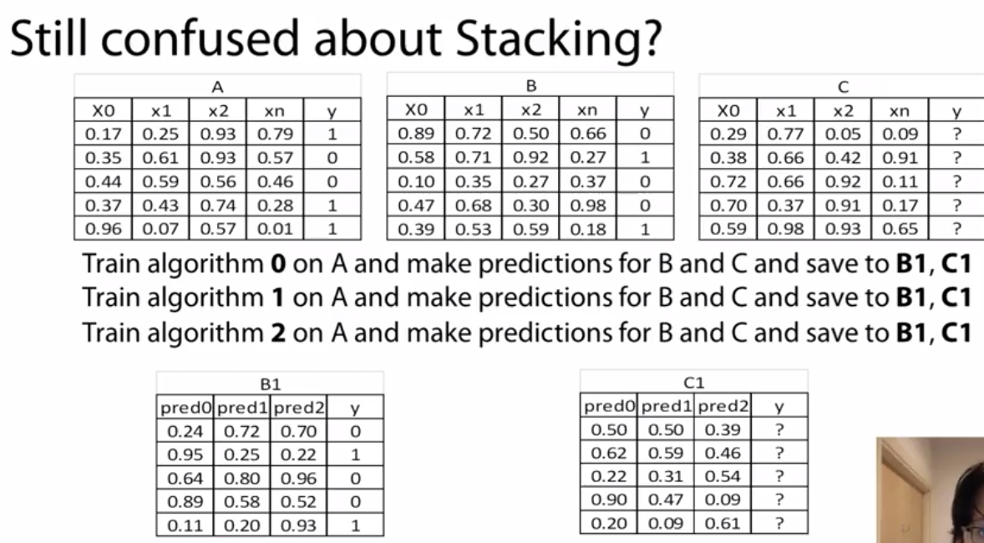

Slide 57
What we do then is we take the target variable for the B data set, or the validation data set.
→ And we’re going to fit a new model on B1 with the target of the validation data, and then we will make predictions from C1.
This how we combine different models with stacking, to hopefully make better prediction for the test or the unobserved data.

Slide 58
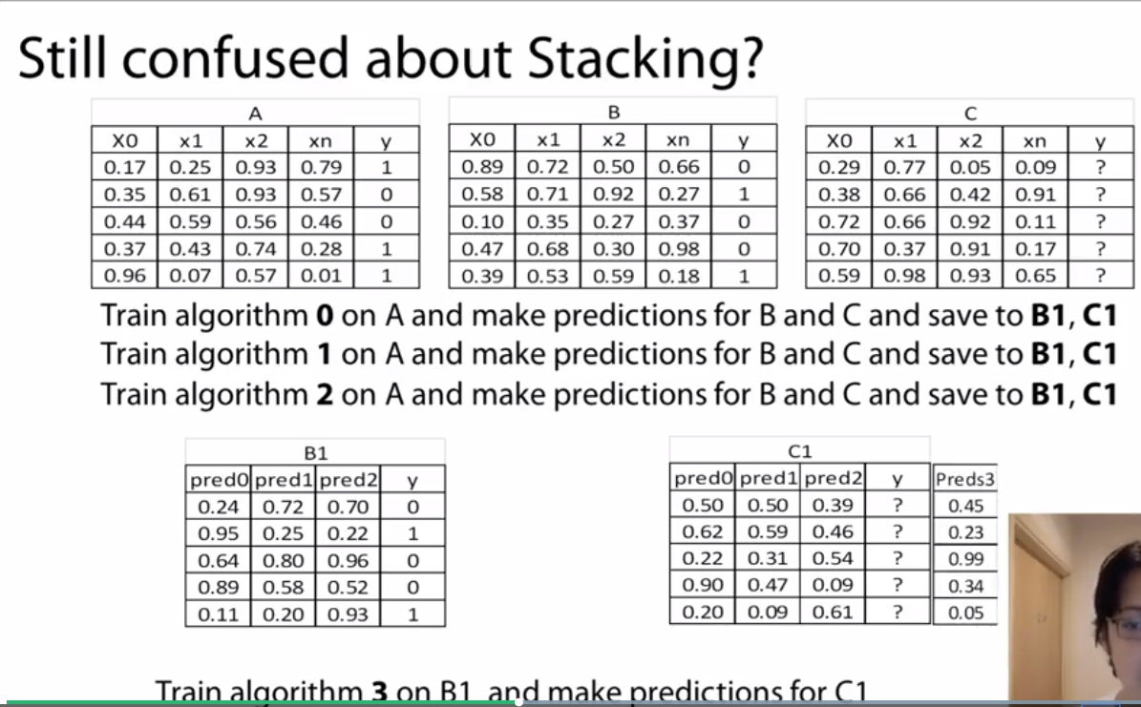

Slide 59
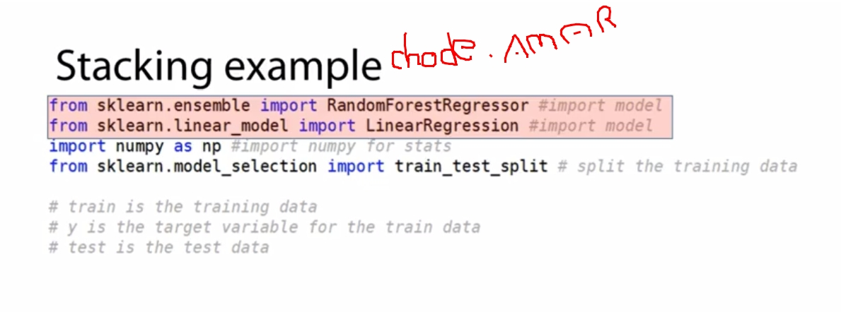

Slide 60
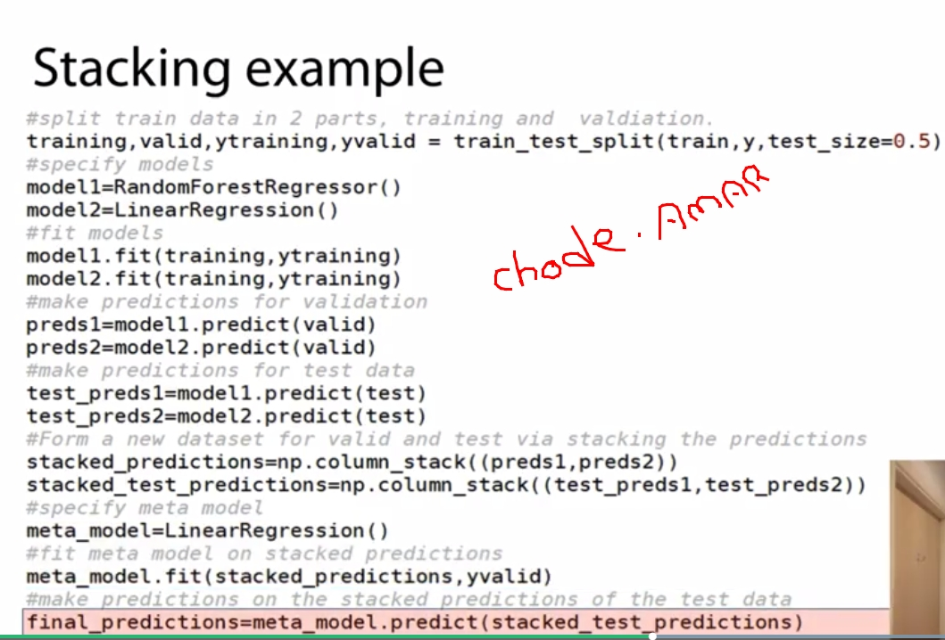

Slide 61
Things to remember
When you have time sensitive data(Time series),
→ when you create your train and validation data, you need to make certain that your train is in past and your validation is in future and ideally your test data is also in the feature.
Model diversity
So you don’t need to worry too much to make all the models really strong,
→ Stacking can actually extract the juice from each prediction.
→ Therefore, what we really need to focus is, am i making a model that brings some information even though it is generally weak?

Slide 62
Normally, you introduce diversity from two forms,
1) different algorithm.
2) Different input feature.
Example:
Linear model will focus on a linear relationship,
Non linear model can capture better a nonlinear relationship.
The other thing is you can even run the same model, but you try to run it on different transformation of input data,
→ Either less features or completely different transformation.
In one dataset you may treat categorical features with One hot encoding.in other you may just using label encoding

Slide 63
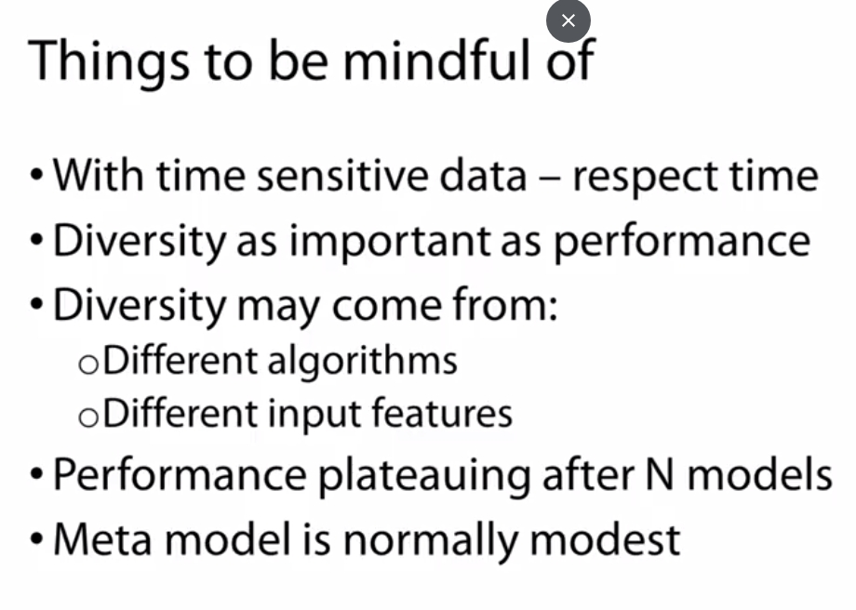

Slide 64
Materials
https://www.coursera.org/learn/competitive-data-science/supplement/JThpg/validation-schemes-for-2-nd-level-models

Slide 66
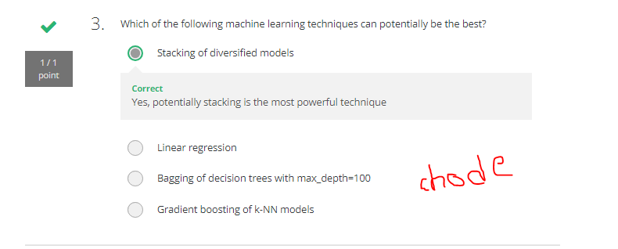

Slide 67
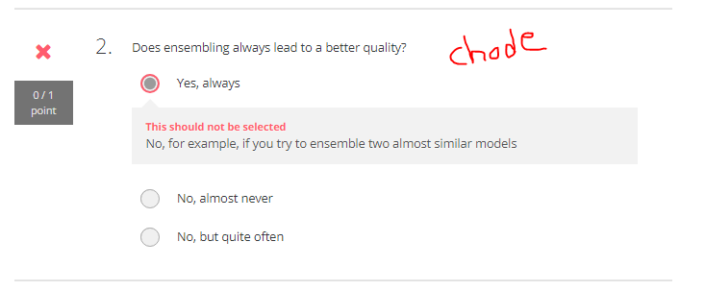

Slide 68
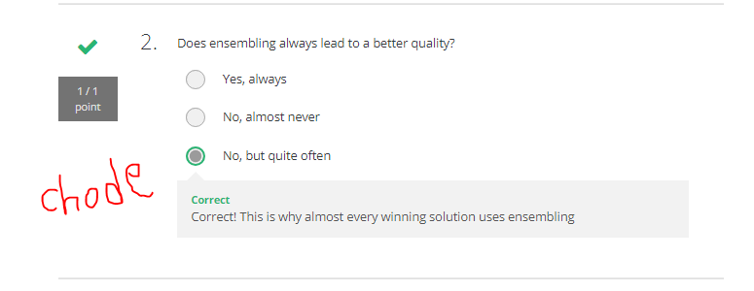

Slide 69
